Slide 1
Transformer
By Dr. Ali Saeed

Slide 2
Transformer
A transformer is a deep learning model. It is distinguished by its adoption of self-attention, differentially weighting the significance of each part of the input (which includes the recursive output) data. It is used primarily in the fields of natural language processing (NLP) and computer vision (CV).
Transformer is a deep learning model used in NLP. Transformer made it possible to facilitate greater parallelization during training and thus enabled training for larger data sets.

Slide 3
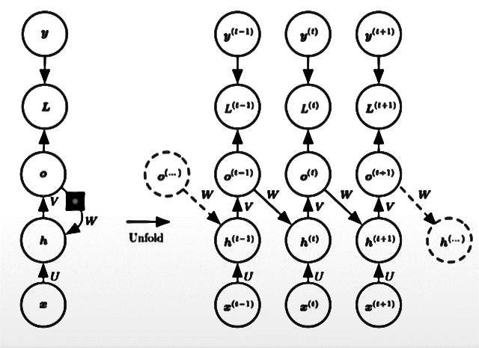
RNN
RNN are feedforward NN rolled out during time
It is good for sequence data
It is use to develop various architectures
  Vector to Sequence Model
  Sequence to Vector Model
  Sequence to Sequence Model

Slide 4
Vector to Sequence Model
Input is fixed size Vector and Output is Sequence
  Example:
  Input
  Vector
  Temperature, Humidity
  Hot , 70%
  Cool, 60%
  Hot, 80%
Output
Sentence:
Today is a hot day with a less probability of rain.

Slide 5
Sequence to Vector Model
Input is fixed size Vector and Output is Sequence
  Example:
Input
Sentence:
Today is a hot day with a less probability of rain.
  Output
  Vector
  Temperature, Humidity
  Hot , 70%
  Cool, 60%
  Hot, 80%

Slide 6
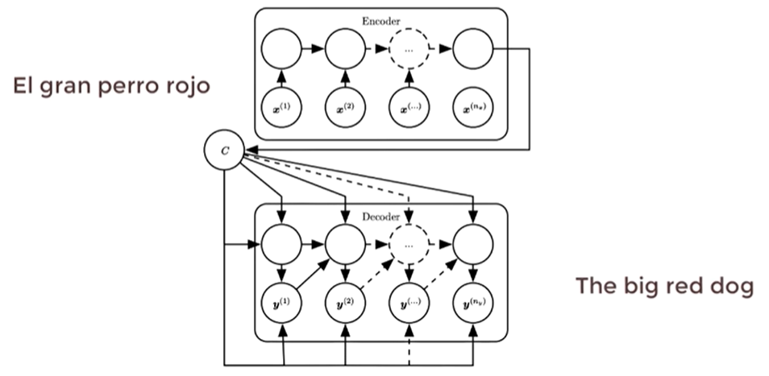
Sequence to Sequence Model
Input and output both are variable length sequences.

Slide 7
Problem in Classical RNN
These are slow to train
Has gradient Vanishing problem
LSTM has solved (gradient Vanishing problem)
LSTM remembers the Cell state of the previous input that saves processing
This allow to maintain the memory for long sequences
LSTM are slow to train (even slower then RNN)
In RNN-LSTM input data need to pass sequentially
  (The red dog) One word to each cell
  The previous cell state called dependencies
  Such configuration are not useful for current GPU computers (that enables parallel processing)
  How can we use parallelization in sequential data? Answer = Transformer

Slide 8
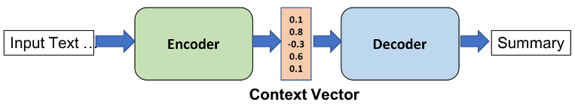
Transformer
It has Encoder-Decoder architecture
Encoder – decoder architecture is a form of neural network architecture which are most suitable for the use cases where input is sequence of data and output is another sequence of data like machine translation use case.
In other words, encoder-decoder architecture are most suitable for sequence-to-sequence modeling

Slide 9
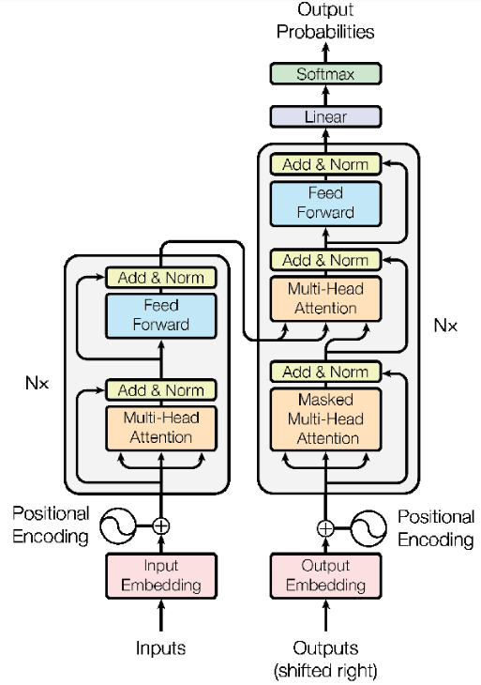
Encoder-Decoder
Architecture

Slide 10
Transformer
The main advantage of Transformer is that input sequences can be passed in parallel.
Example:
How are you? In RNN we pass “How” to RNN, then “are” to RNN and then “you” to RNN. But in Transformer, we pass complete sentence at one time.
RNN generate “Word Embeddings” one by one
In transformer no need of time stamp. It calculate “Word embedding” at one time
Transformer works on the concept of “parallel processing”

Slide 11
How to achieve parallelization
Computer do not understand words
They understand numbers vectors OR Word embeddings
So Transformer convert the “sentence” into “vectors” at once
Word embeddings is to embed to words into vector space that similar words in meaning comes closer to each other
The space in which words are embedded are called embedding space
We can also use pretrained embedding space
  Glove
  Word2Vec
This embedding can map words into vectors

Slide 12
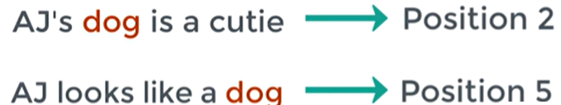
Transformers
Transformers uses “positional encoding”

Slide 13
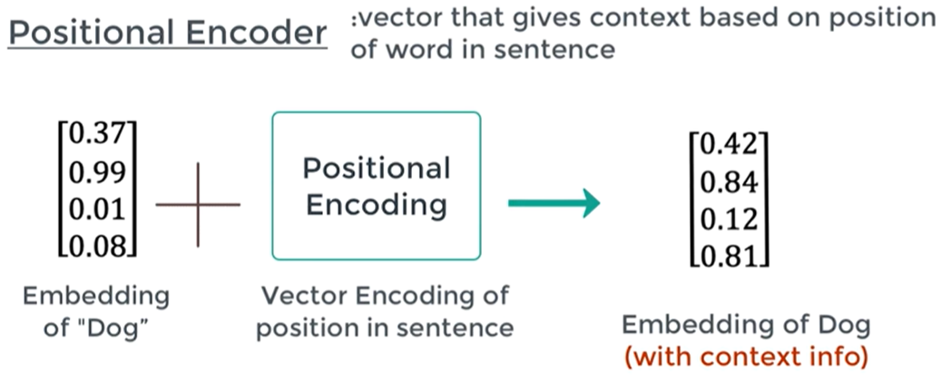
Working of Positional Encoder

Slide 14
Encoder Block
We pass “final embedding info” to the encoder block
In encoder block we have two main components
  Multi-Head attention layer
  Feed-forward network layer
Multi-Head attention layer: It inform that what part of the input we should focus.
Feed-forward network layer: A Feed Forward Neural Network is an artificial neural network, it allows the model to learn complex patterns and relationships in the data.

Slide 15
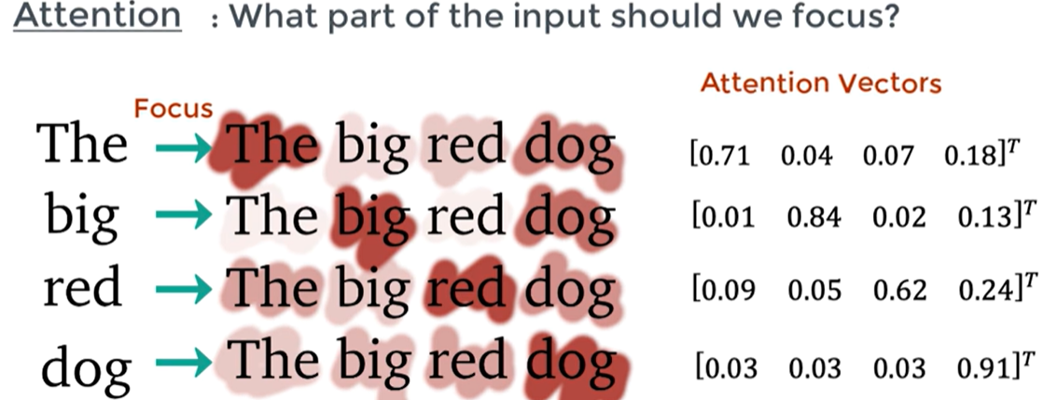
Multi-Head attention layer
It tells us how a ith word of the same sentence is relevant to the other words? This called ith attention vector.
It captures the contextual relationship between the sentences

Slide 16
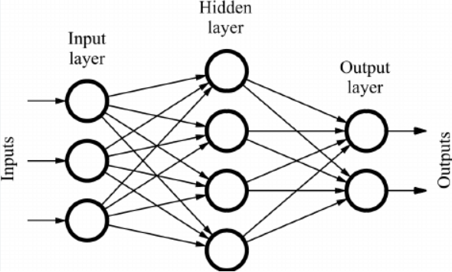
Feed Forward NN
It uses attention block output as input and transform the output in such a way that can be used by decoder block.

Slide 17
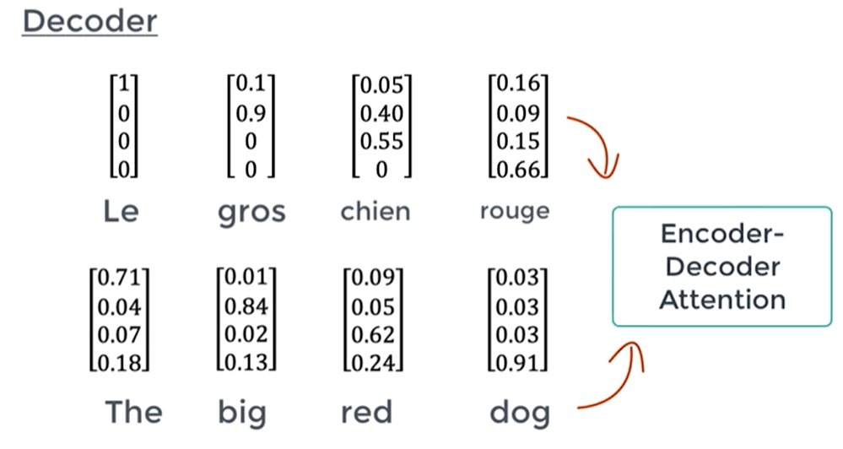
Decoder
The transformer decoder is crucial in generating the final output sequence. Without the transformer decoder, there would be no way to generate the output sequence. Without an encoder, the transformer decoder would miss important contextual information, resulting in lower-quality output
Similar to encoder Decoder will calculate its “positional embeddings”
Two of decoder components are exactly similar to encoder
One is difference is “Attentional block”
This is where input and output get related

Slide 18
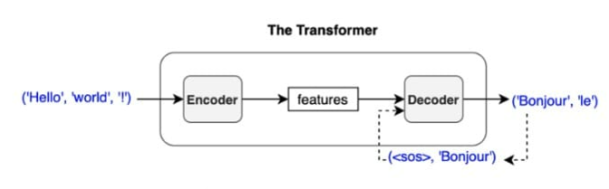
Overall Working of Transformers

Slide 19
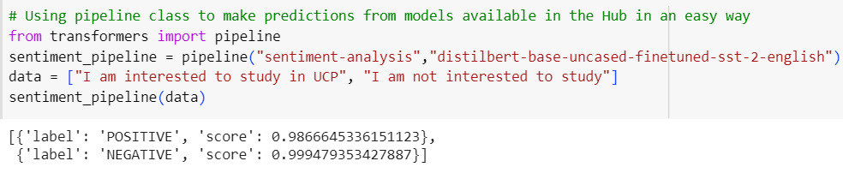
Example of Hugging Face Transformers
Sentiment Analysis

Slide 20

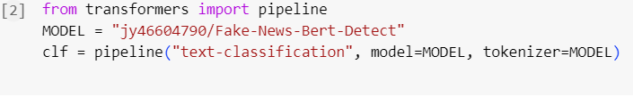
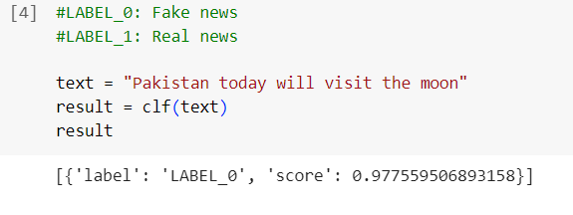
Example of Hugging Face Transformers
Fake News Detection

Slide 21

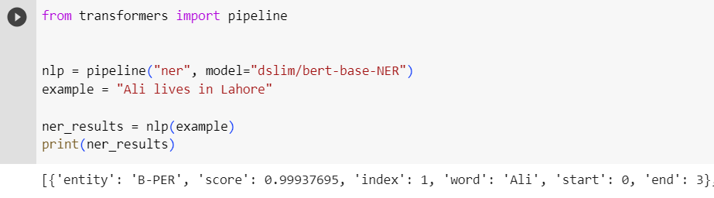
Example of Hugging Face Transformers
Named Entity Recognition (NER)

Slide 22
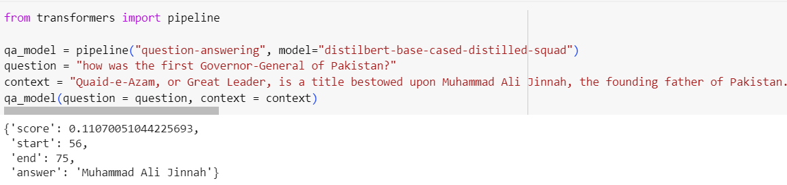
Example of Hugging Face Transformers
Question-Answering Chatbot (contextual learning)

Slide 23
Class Activity
Move on this website: https://huggingface.co/docs/transformers/v4.15.0/task_summary
Text Summarization (Group 1)
Text Generation (Group 2)

Slide 24
Thanks

